Slide 1
Analyzing the Optimal Districts to Start a Restaurant Business in Paris
October 19, 2020 By: Nabih Saleh

Slide 2

Introduction
Paris is the capital and the most populous city in France. The city is known to be a very touristic city welcoming millions of travelers per year from all over the world.
it is widely known that Paris has a number of the most decorated chefs in the world serving all different cuisines from all over the globe.
Business owners and entrepreneurs might be looking to start a new restaurant in Paris
The task is to study each district in Paris and check how the food business is doing there
Figure 1: Paris view

Slide 3
Data
The following data was collected for this project:
Paris district data from https://en.wikipedia.org/wiki/Arrondissements_of_Paris#Arrondissements
Respective latitude and longitude coordinates for each district using GeoPy and Geocoder libraries in python
Venue data for each district in Paris using Foursquare API
The data was then cleaned to produce the final datasets shown in the upcoming slides

Slide 4
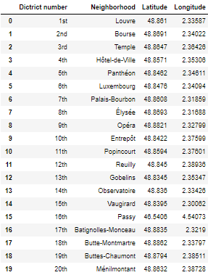
Dataset for Paris Districts
Figure 2: First 10 rows of Paris District Dataframe

Slide 5
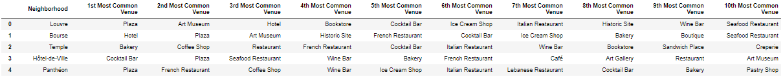
Dataset for Top 10 Most Common Venues
Figure 3: First 10 rows of top 10 most common venues for all districts

Slide 6
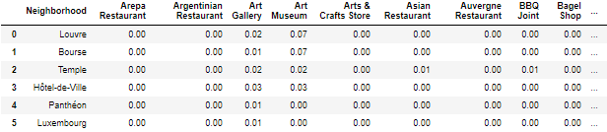
Methodology
One-hot Encoding
One-hot Encoding was used to encode venue categories to numeric values with 1 if a venue belongs to a category and 0 if a venue does not belong to a category for all neighborhoods
The average is then taken for all venue categories in a neighborhood to produce the dataframe shown
Figure 4: One-hot Encoding resulting dataframe

Slide 7
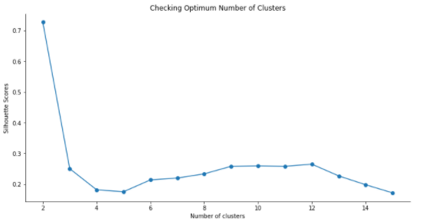
Methodology Continued
Unsupervised Learning Model
KMeans clustering was used to cluster districts in Paris based on venue categories
The plot shows a maximum Silhouette Score for 2 clusters and thus the n_clusters parameter in KMeans clustering was set to 2
Figure 5: Silhouette scores for varying number of clusters in KMeans clustering

Slide 8
Results
Each neighborhood received a cluster label based on clustering by the KMeans algorithm
The Cluster Label column along with the Location, Latitude, and Longitude columns were added to the top 10 most common venues dataframe to provide the final results
This dataframe is shown on the next slide

Slide 9
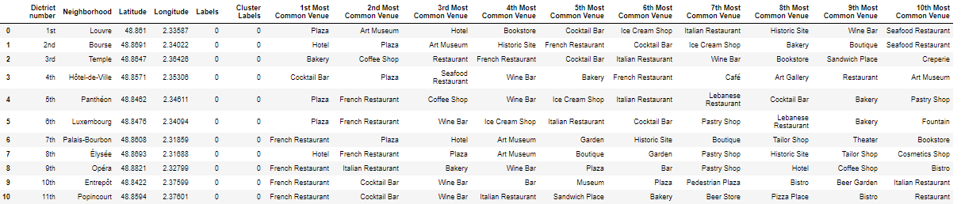
Results Continued
Figure 6: First 10 rows of clustering districts in Paris dataframe

Slide 10
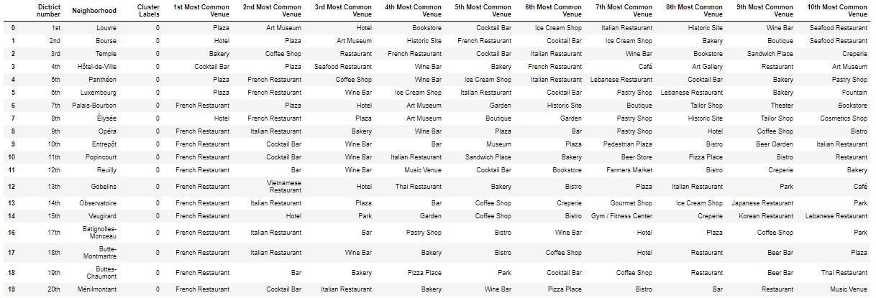
Results Continued – Cluster 1
Analyzing each cluster individually
Figure 7: Cluster 1

Slide 11
Results Continued – Cluster 2
Figure 8: Cluster 2

Slide 12
Discussion
Analysing the different clusters, we can see that cluster 1 is more suited for restaurants and hotels than the other. Cluster 2 contain a small percentage of restaurants in the top 10 common venues compared to the other districts. Thus, the 16th district (Passy) is not well suited to open up a restaurant.
On the other hand, clusters 1 contains a large number of restaurants, hotels, cafes, bistros, bakeries and bars which indicates the districts in these clusters are suited for opening a restaurant.

Slide 13
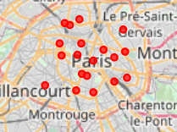
Discussion Continued
Figure 14: Visualizing the appropriate districts in Paris

Slide 14
Conclusion
We have successfully determined what would be the most appropriate districts to open a new restaurant business.
We have found that all the districts belonging to cluster 1 would be appropriate locations.
However, investors should also consider other factors before choosing the location such as the cost associated with the location.

